Slide 1
Real Estate Business Domain
Abhigyan Sinha
VT20222029

Slide 2

A rapidly evolving industry
It is subject to many price fluctuations due to the correlations that exist with many variables, some of which cannot be controlled or may even be unidentifiable.

Slide 3
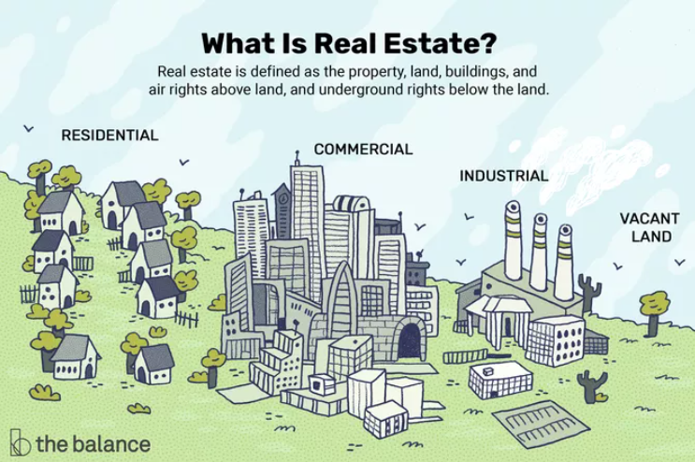
Introduction
Real property, sometimes referred to as “real estate,” is technically land plus any other tangible improvements that may be located or installed on it.
Your home is real estate, but so is any vacant land you may own. Real estate can be a skyscraper in New York or a piece of desert land that is undeveloped and cannot be built on.
Real estate can include property, land, buildings, rights in the air, and rights underground. This term refers to real or physical property. As a business term, real estate also refers to the production, purchase and sale of goods.

Slide 4
How Real Estate Works
Real estate has many facets because it simply does not exist. It can go from non-enhanced to advanced. It can be bought or sold. It can be owned by a government, corporation or a private party.
Construction of new buildings The construction of new homes is an important category. It includes the construction of single-family homes, townhouses and condominiums. The National Association of Home Builders (NAHB) provides monthly data on home sales and average prices. New home sales data is a leading economic indicator. It takes four months to establish new home sales trends.
Real Estate Agents
Real estate agents assist individuals, businesses, and investors in buying and selling properties.
Sellers help find buyers through the Multiple Listing Service or their professional contacts.
Buyers' agents provide similar services for the home purchaser. They know the local market, so they can find a property that meets your most important criteria.

Slide 5


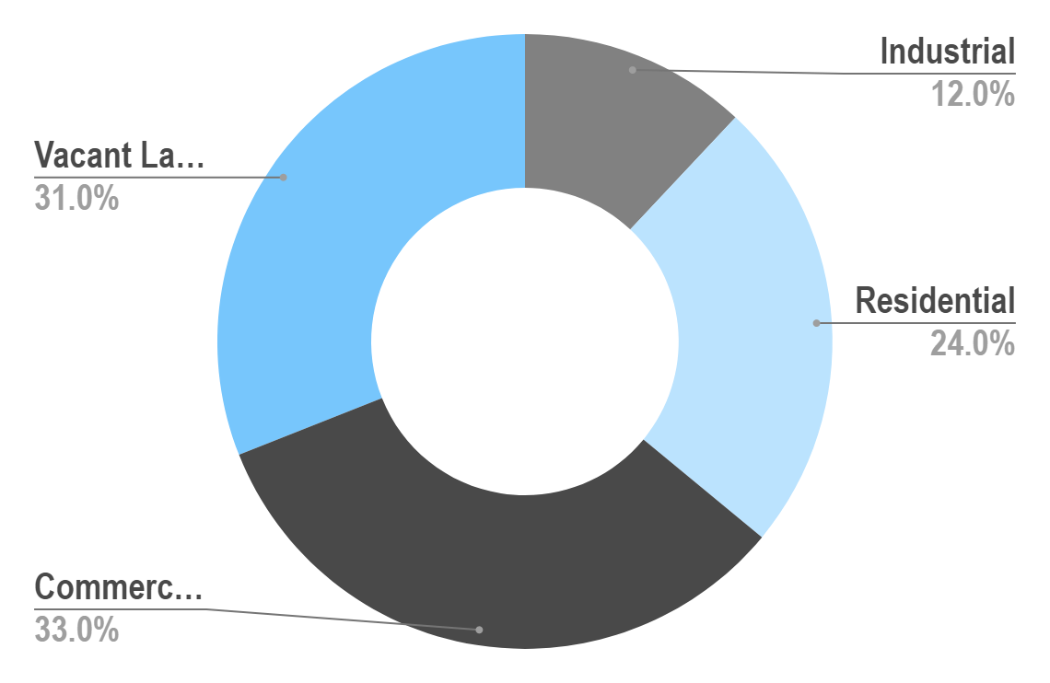

Types of Real Estates
Vacant Land
Industrial Real Estates
This includes vacant lots, working farms and ranches
This include factories and warehouses
Commercial Real Estates
Residential Real Estates
This includes shopping centers, hospitals, offices etc.
This includes both new construction and resale homes.

Slide 6
Behavior Of The Market
01
02
Macroeconomic Perspective
Global
Perspective
The aspects under this perspective that significantly drive the behavior of the market are:
Demographics
Interest rates
Govt. regulation
Global economic health
The aspects under this perspective that significantly drive the behavior of the market are:
Political Instability
Emergence of Hot-Spots

Slide 7
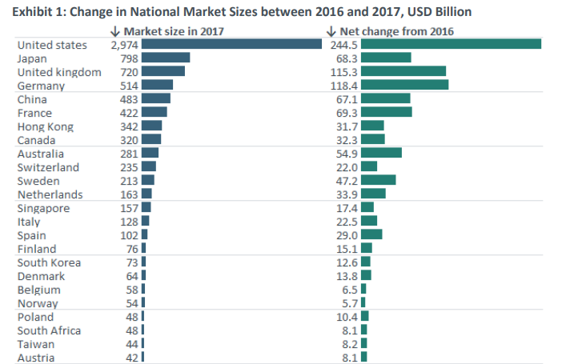
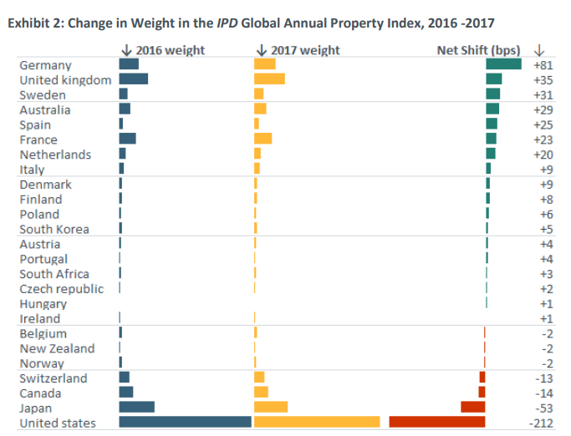
Price Fluctuation in Real Estate Market
Housing prices can increase/decrease rapidly yet the numerous listings available online where houses are sold or rented are not likely to be updated that often.
A recent report published by MSCI inc. estimated the size of the professionally managed real estate market expanded to $8.5 trillion in 2017 from $7.4 trillion in 2016, a total increase of $1.1 trillion year-over-year.

Slide 8
Most important Factors determining the value of a house
Size
Location
01
02
1, 2, 3 BHK
1, 2 RK
Finding a location that is comfortable, safe and within your budget
Area Type
Property Type
03
04
Super Built-up Area
Plot Area
Built-up Area
Apartment, Mansion, Farmhouse, Bungalow

Slide 9
Other Factors
01
02
03
04
Proximity to some public transport
A property’s distance to the public transport system positively influences its renting price.
Schools in vicinity
Sometimes the best possibilities might be a school, which can be a boon for those with children in the family.
Shopping affordability
Stores to provide you with a smooth and a reliable shopping experience.
Availability of garden/parks
Parks are integral part of the urban environment playing economic, structural, socio-cultural and ecological roles for the sustainence of urban areas.

Slide 10
Buyer Behavior And Intent
How do you determine if a multi-family offer is better than another?
As a real estate investor, operator and distributor. An important part of your analysis when looking at real estate for investment is looking at the property's past performance. This includes analyzing various factors including vacancy rates, bad debts, incentives, income and expenses.
We not only look at real estate performance over the past six or 12 months, but also look for trends. This indicates the future performance of the asset. The current real estate market is a seller’s market, so matching the right people with the right places at the perfect price point is a profit-driving value proposition.
In addition, different market segments are developing at different rates, such as luxury apartments.

Slide 11
Exemplar Statistics
Real estate statistics give agents, investors, and clients data-based insights into the constantly shifting housing market.

Slide 12
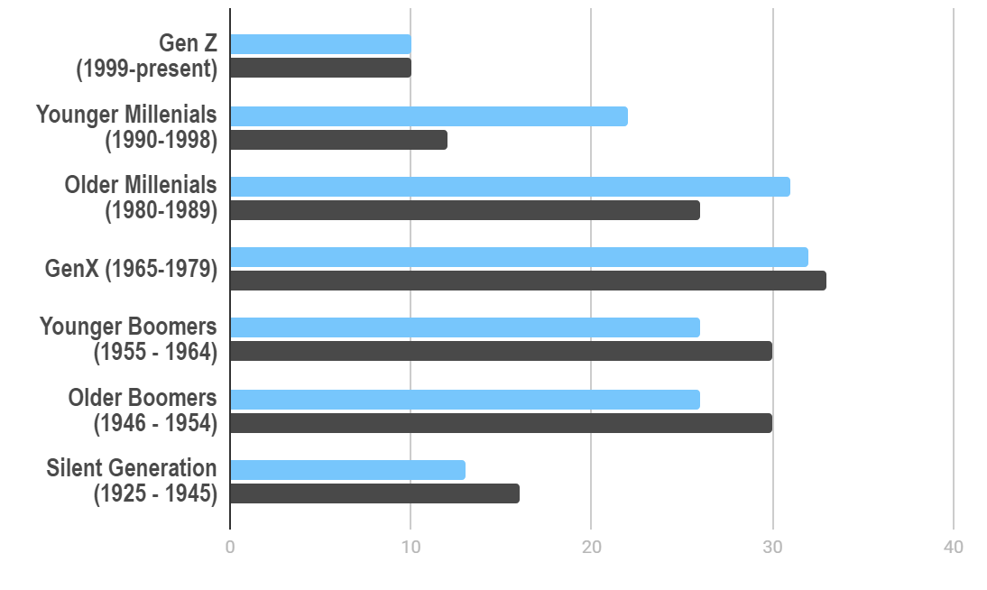
Gen X is the biggest generation of homebuyers
Share of Housing Market 2021 (By Generation)
32%
Gen X is the biggest generation of homebuyers
45K
33%
Gen X is the biggest generation of homesellers

Slide 13
43% of homebuyers search online before contacting an agent
43%of buyers search online first, and only 18% contact a dealer first. 97% of homebuyers have researched a home online at some point in the buying process.
These real estate statistics do not make agents obsolete. In fact, this provides an opportunity to enhance digital marketing strategies, especially during a pandemic when mobility is limited.
While more and more buyers prefer to consult the web first, 87% of buyers in 2021 still find their real estate agent a useful or very reliable source of information. This is not surprising, considering the complexity of the home buying process and all the legal issues that can arise.

Slide 14
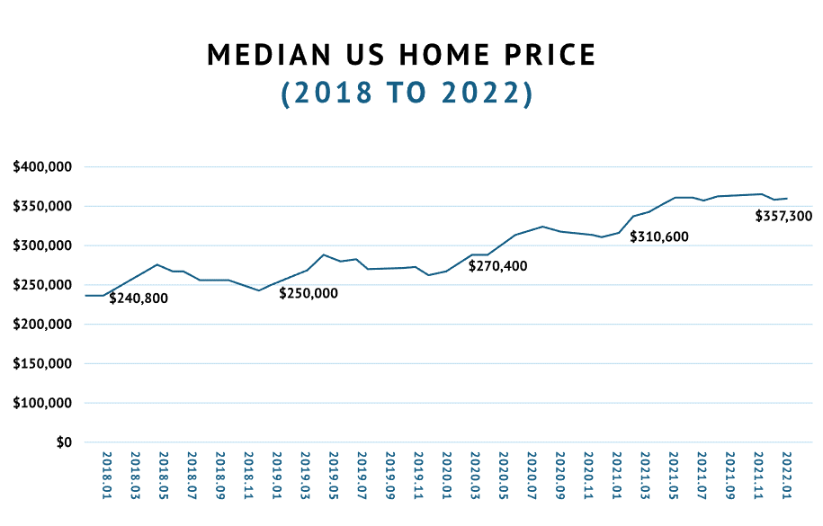
The median home price in 2022 is $357,300
House prices rose dramatically through 2021 and into 2022. Between 2019 and 2020, median house prices rose only $20,400, but between 2020 and 2021, they rose $40,200.
Then, between January 2021 and January 2022, they rose over $46,700, totaling the median home price to $357,300.

Slide 15
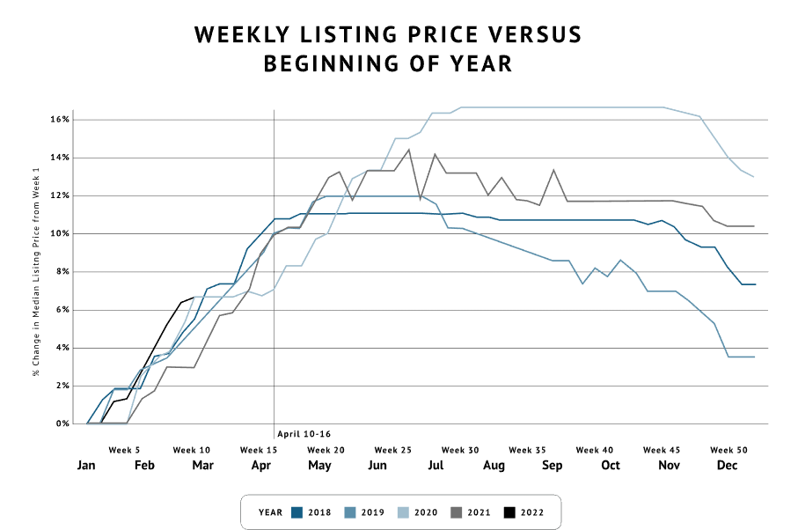
Homes listed online from April 10 to 16 sell fastest & highest
Many people do not realize that there are both good and bad times to list your home.
Real estate stats show homes listed between April 10 and 16 sell at a higher price than any other time of the year.

Slide 16
The median home price in 2022 is $357,300
House prices rose dramatically through 2021 and into 2022. Between 2019 and 2020, median house prices rose only $20,400, but between 2020 and 2021, they rose $40,200.
Then, between January 2021 and January 2022, they rose over $46,700, totaling the median home price to $357,300.

Slide 17

Bottom Line
Understanding the data and the trends in homeownership, buying and selling and renting habits as well as use of technology and agents in real estate statistics can help you make informed property decisions and the right price.

Slide 18
Use of AI & ML in Real Estate
Machine learning is a form of artificial intelligence that has the ability to learn from prior experience without doing any additional programming.
We use AI and ML to help us choose which markets to focus on by analyzing how properties will perform in the future.

Slide 19
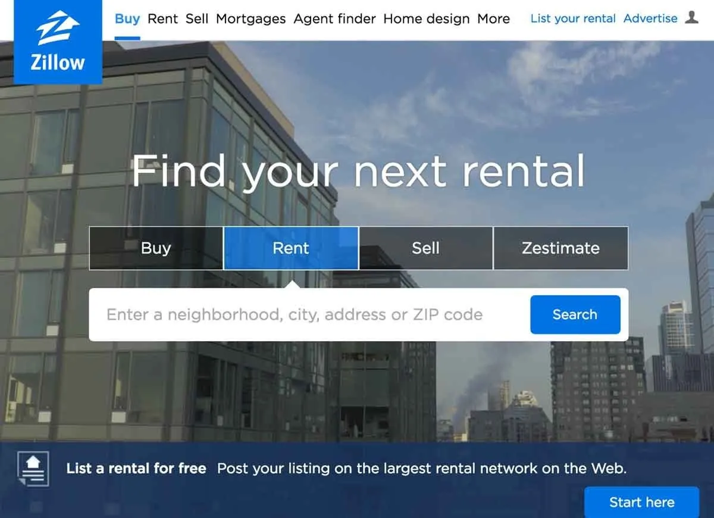
Websites Using The Concept
Many times we have come across websites like "Magicbricks.com“ and “Zillow.com” where they sell and estimate the price of the property in many part of the country, so this model is also inspired by the concept of predicting property prices based on the area, bedrooms, bathrooms and location.

